Slide 1

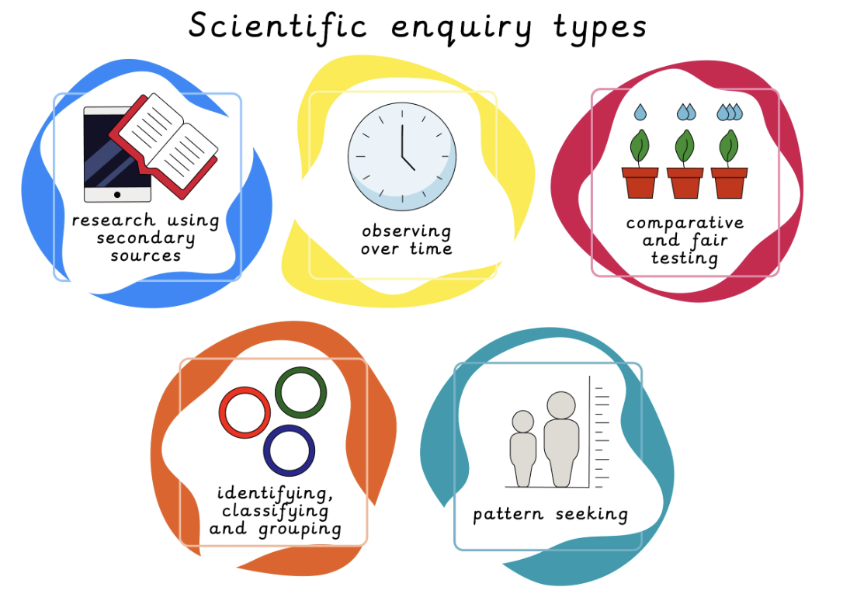
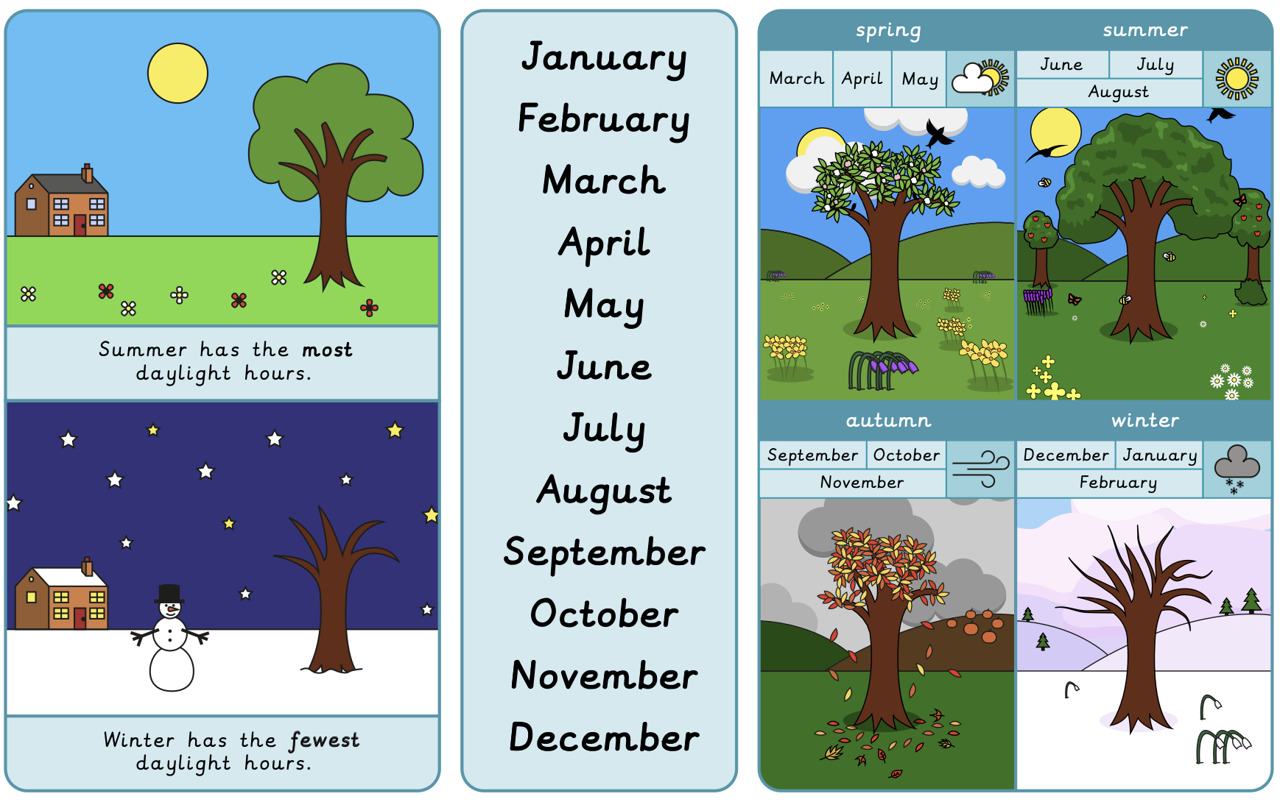
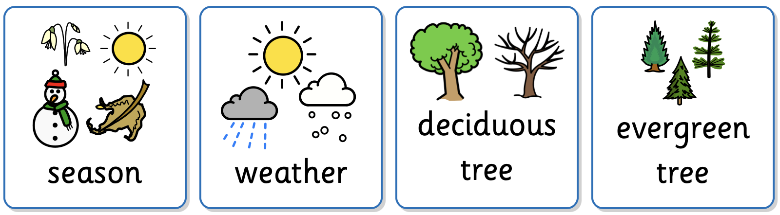
Year 1 Forces and Space: Seasonal Changes Prior Learning: Changing Seasons (EYFS)
Lesson 1: Wonderful weather LO: To identify how the weather changes across four seasons. | Lesson 2: Seasonal activities LO: To identify events and activities that take place in different seasons. | Lesson 3: How do trees change? LO: To recognise how trees change across the four seasons. | Lesson 4: Daylight hours LO: To recognise that daylight hours change across the four seasons. | Lesson 5: Observing over time LO: To observe changes across the four seasons. | Lesson 6: Weather reports LO: To observe changes across the four seasons.
Working Scientifically
To record data in a pictogram. To gather and record data about how seasons change over time.
Key Vocabulary
season | One of four parts of a year, marked by the weather conditions.
weather | The short-term conditions in a particular place.
deciduous tree | A tree which sheds its leaves seasonally.
evergreen tree | A tree which keeps its green leaves all year.

