Slide 1

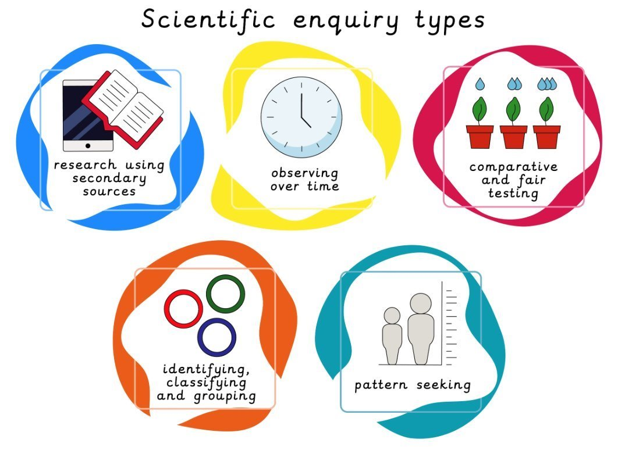
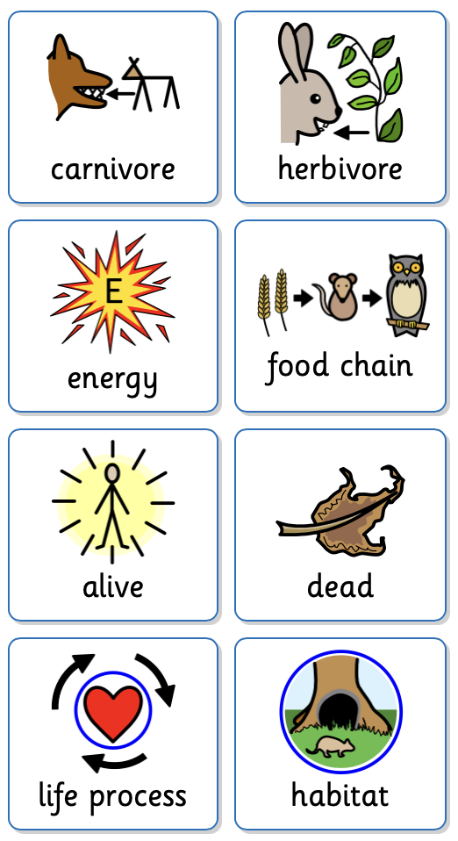
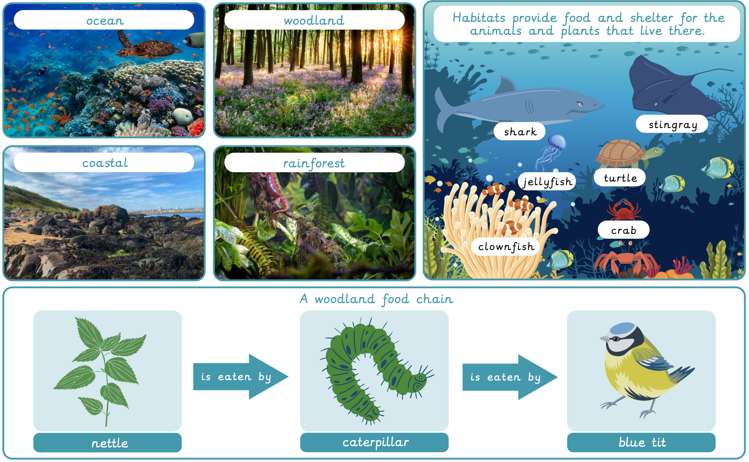
Year 2 Living things: Habitats
Lesson 1: Life processes LO: To identify some of the characteristics of living things. | Lesson 2: It feels good to be alive LO: To recognise the difference between things that are alive, were once alive or have never been alive. | Lesson 3: Introduction to habitats LO: To identify plants and animals in different habitats | Lesson 4: Woodland habitats LO: To identify how a habitat provides animals and plants with what they need to survive. | Lesson 5: Rainforest and ocean habitats LO: To recognise how animals and plants depend on each other. | Lesson 6: Food chains LO: To recall how animals get their food from plants and other animals.
Key Vocabulary
carnivore | An animal that only eats meat.
herbivore | An animal that only eats plants and vegetables.
energy | The strength required to stay alive.
food chain | The series of organisms that each depend on the next as a source of food.
alive | A person, animal or plant that is living.
dead | A person, animal or plant that is no longer living.
life process | The functions that plants and animals go through to stay alive.
habitat | The natural environment or home where a plant or animal lives and grows.
Working Scientifically
To classify objects into groups. To carry out research to find answers to questions.

