Slide 1

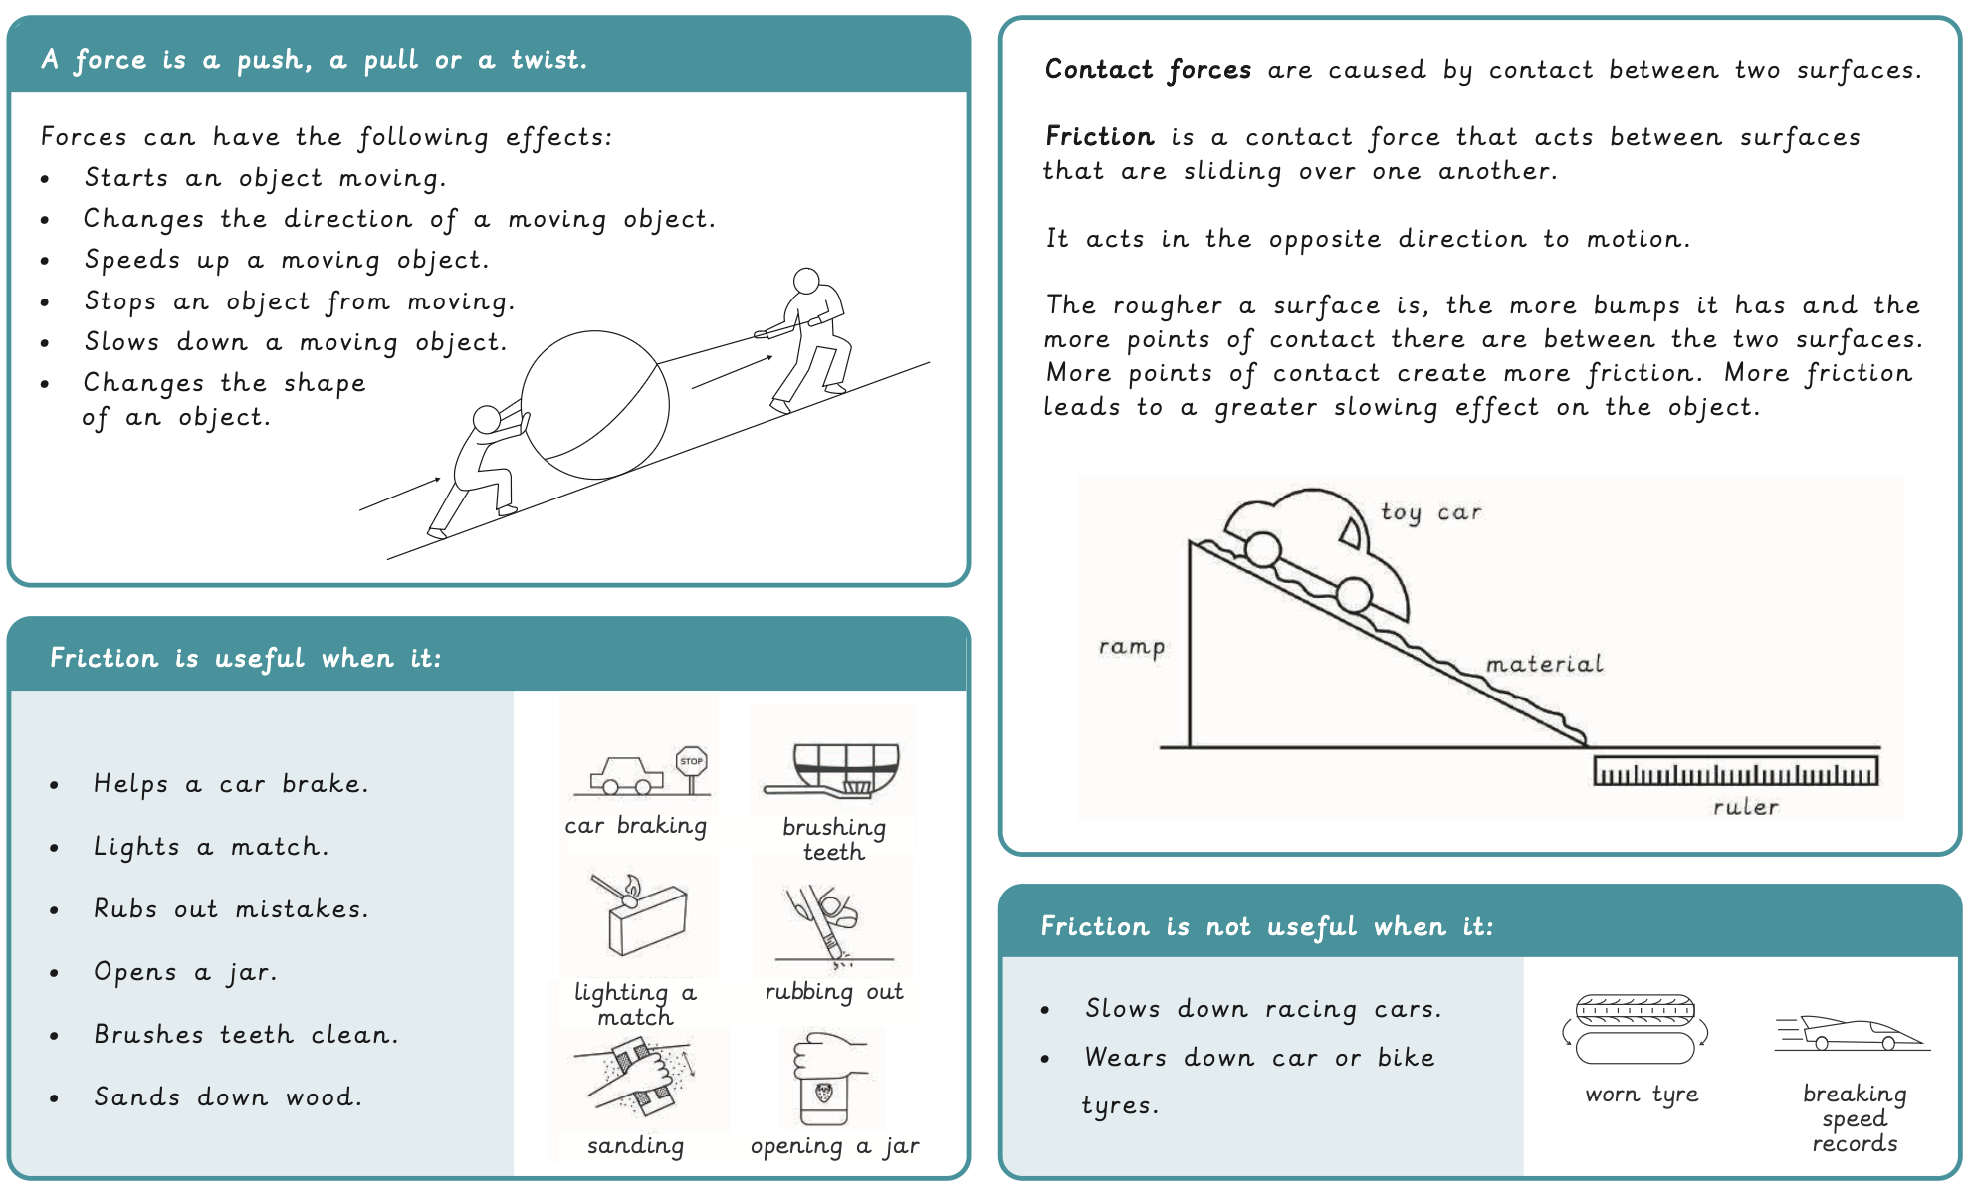
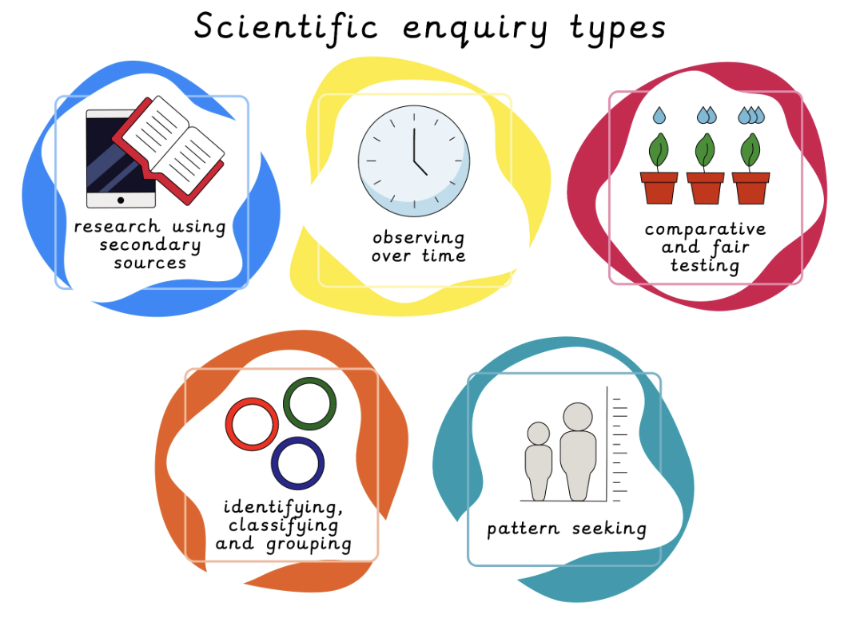
Year 3 Forces and Space: Forces and Magnets Prior Learning: Use of everyday materials (Year 2)
Lesson 1: Pushes, pulls and twists LO: To describe the effects of contact forces. | Lesson 2: Friction LO: To recognise the effects and uses of forces. | Lesson 3: Investigating friction LO: To interpret how and why things move differently on different surfaces. | Lesson 4: Magnets LO: To describe the effects of magnets. | Lesson 5: Investigating magnet strength LO: To compare the properties of different types of magnets. | Lesson 6: Uses of magnets LO: To explain the uses of magnets.
Working Scientifically
To label a diagram using scientific vocabulary. To write a scientific conclusion. To plan an investigation. To write a method. To display data using a bar chart. To research the use of magnets.

Slide 2

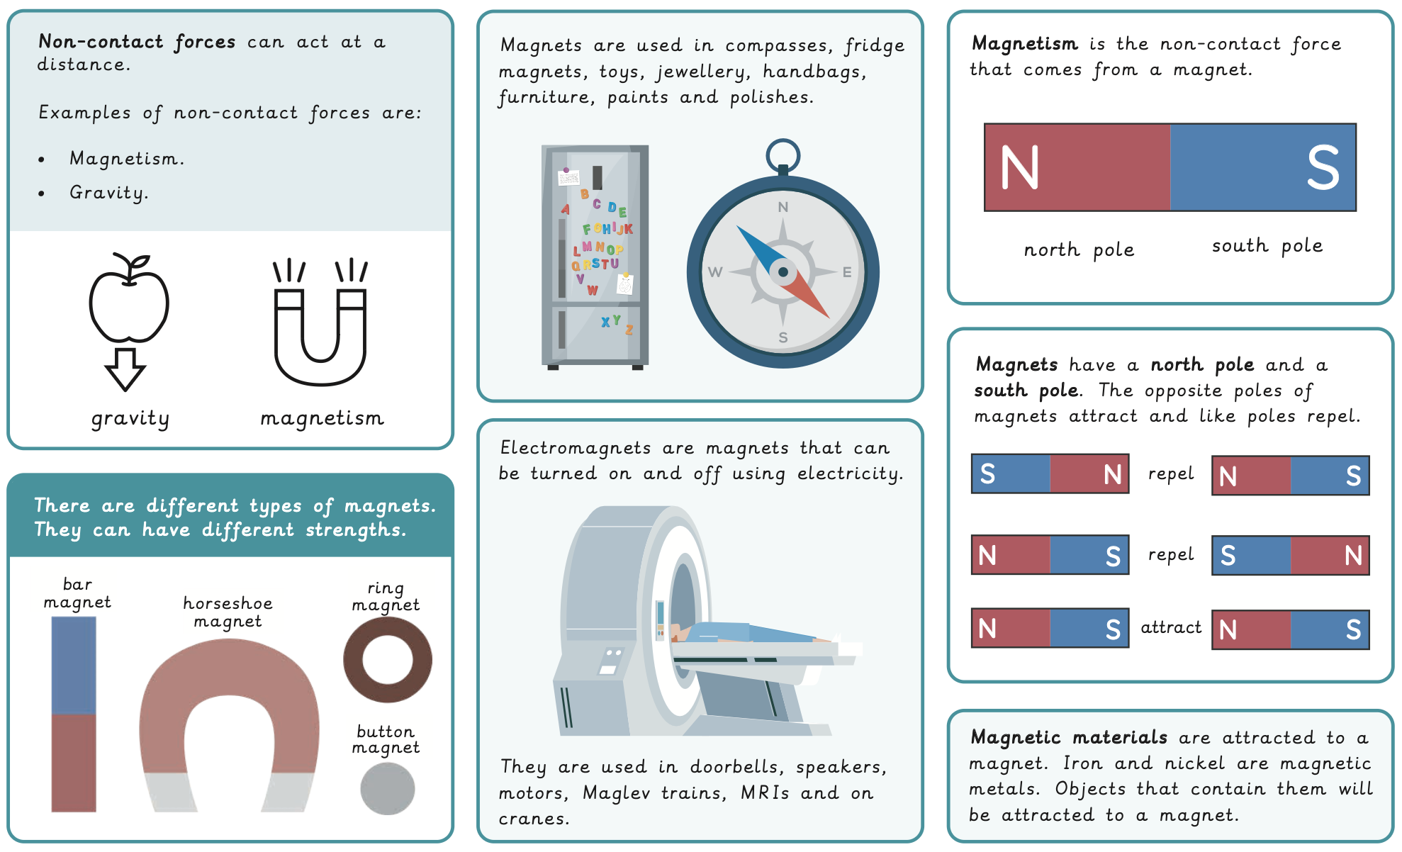
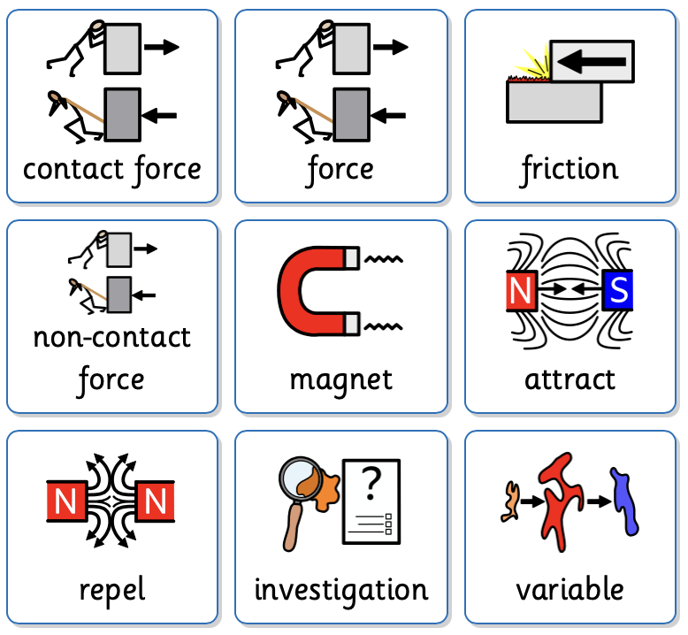
Key Vocabulary
contact force | A force caused by contact between two surfaces.
force | A push, pull or twist.​
friction | A force between two surfaces in contact that opposes motion.
non-contact force | A force that acts at a distance.
magnet | An object that has a magnetic force around it.
attract | To pull towards.
repel | To push away.
investigation | Using a scientific method to gather evidence to help answer a question.
variable | Something that can change and cause an effect.

