Slide 1

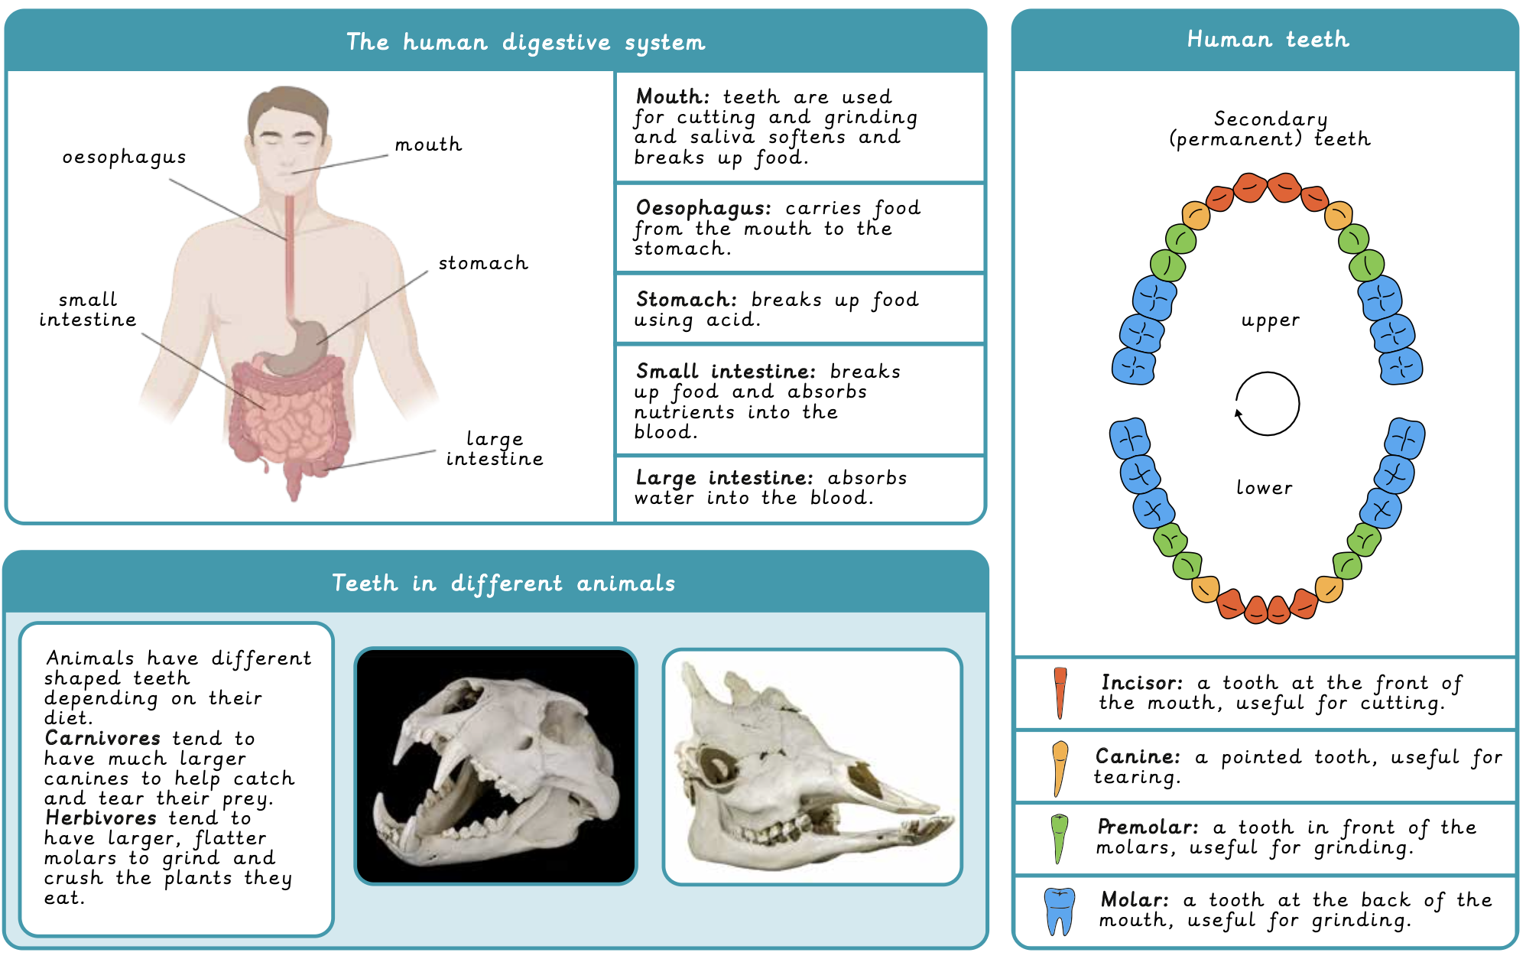
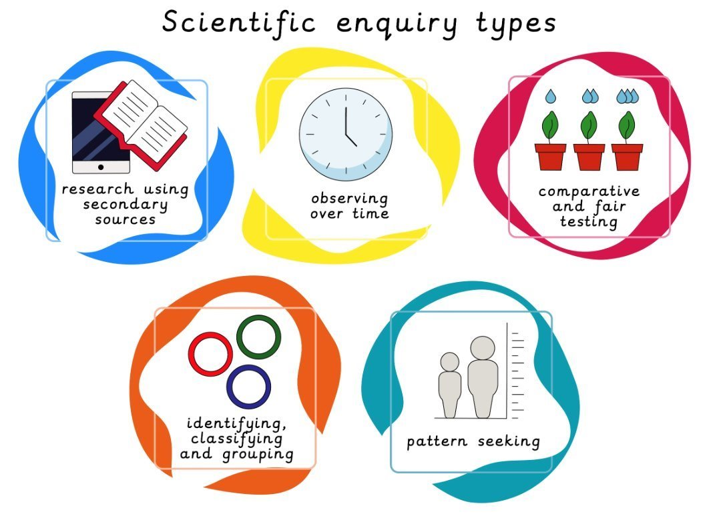
Year 4 Animals including humans: Digestion and food Prior learning: Animals: Movement and Nutrition (Year 3)
Lesson 1: The human digestive system LO: To describe the function of the human digestive system. | Lesson 2: Human teeth LO: To recognise the different types of human teeth and their roles in eating. | Lesson 3: Investigating dental hygiene LO: To explain how to care for our teeth. | Lesson 4: Teeth of omnivores, herbivores and carnivores LO: To recognise that differences in teeth relate to an animal’s diet. | Lesson 5: Producers, predators and prey in food chains LO: To recognise producers, predators and prey in food chains. | Lesson 5: Poo clues LO: To recognise that animal poo can give us clues about digestion, teeth and diet.
Working Scientifically
To evaluate a model. To plan an enquiry by considering which variables should be changed, measured and controlled. To group animals based on their diet. To analyse patterns and form conclusions using scientific knowledge. To construct a results table for recording observations.

Slide 2
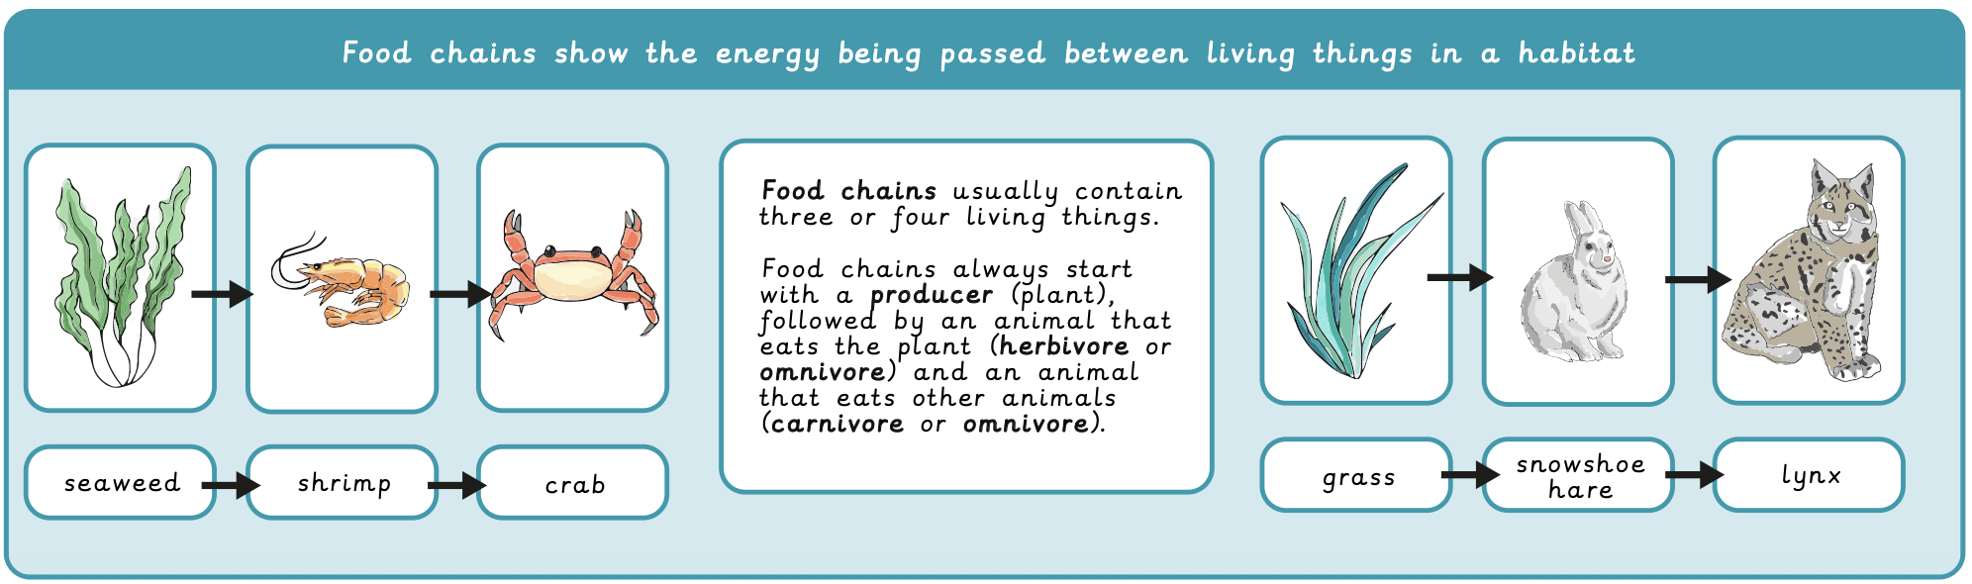
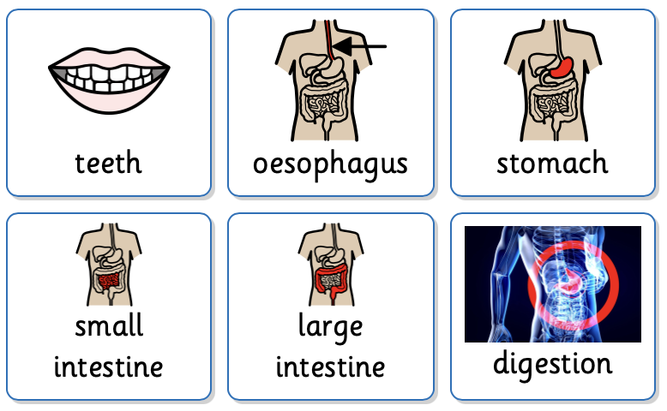
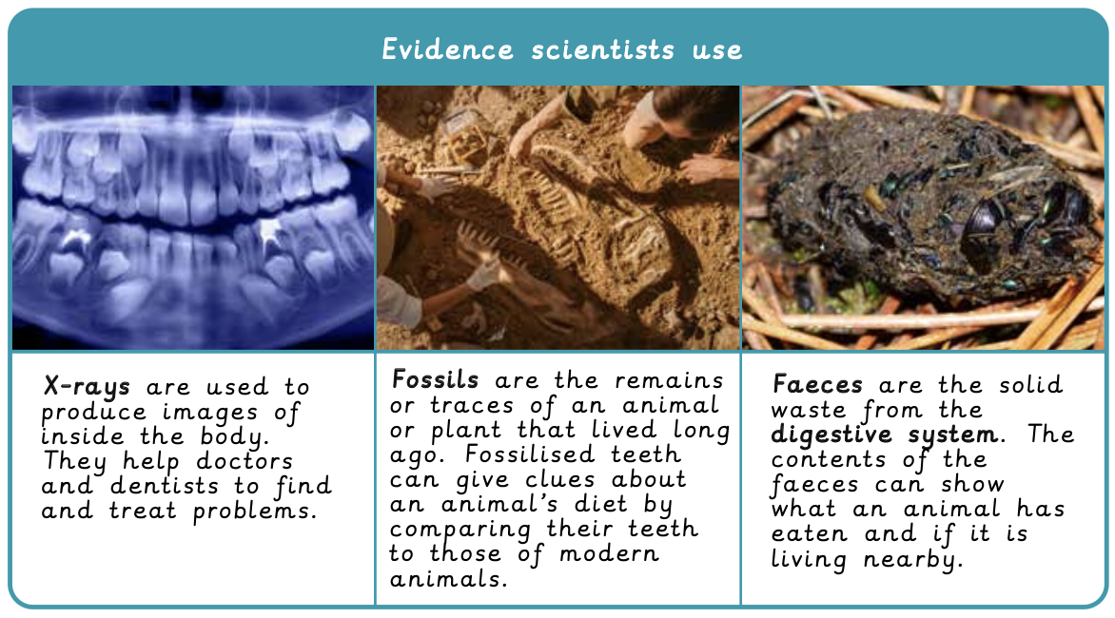
Key Vocabulary
teeth | Teeth are used for cutting and grinding and saliva softens and breaks up food.
oesophagus | Carries food from the mouth to the stomach.
stomach | Breaks up food using acid.
small intestine | Breaks up food and absorbs nutrients into the blood.
large intestine | Absorbs waters into the blood.
digestion | The process of breaking down food into smaller, simpler particles that the body can absorb.

