Slide 1

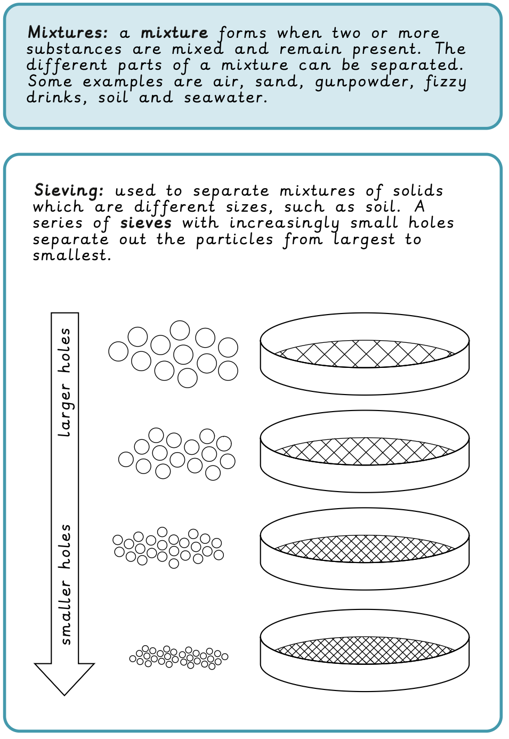
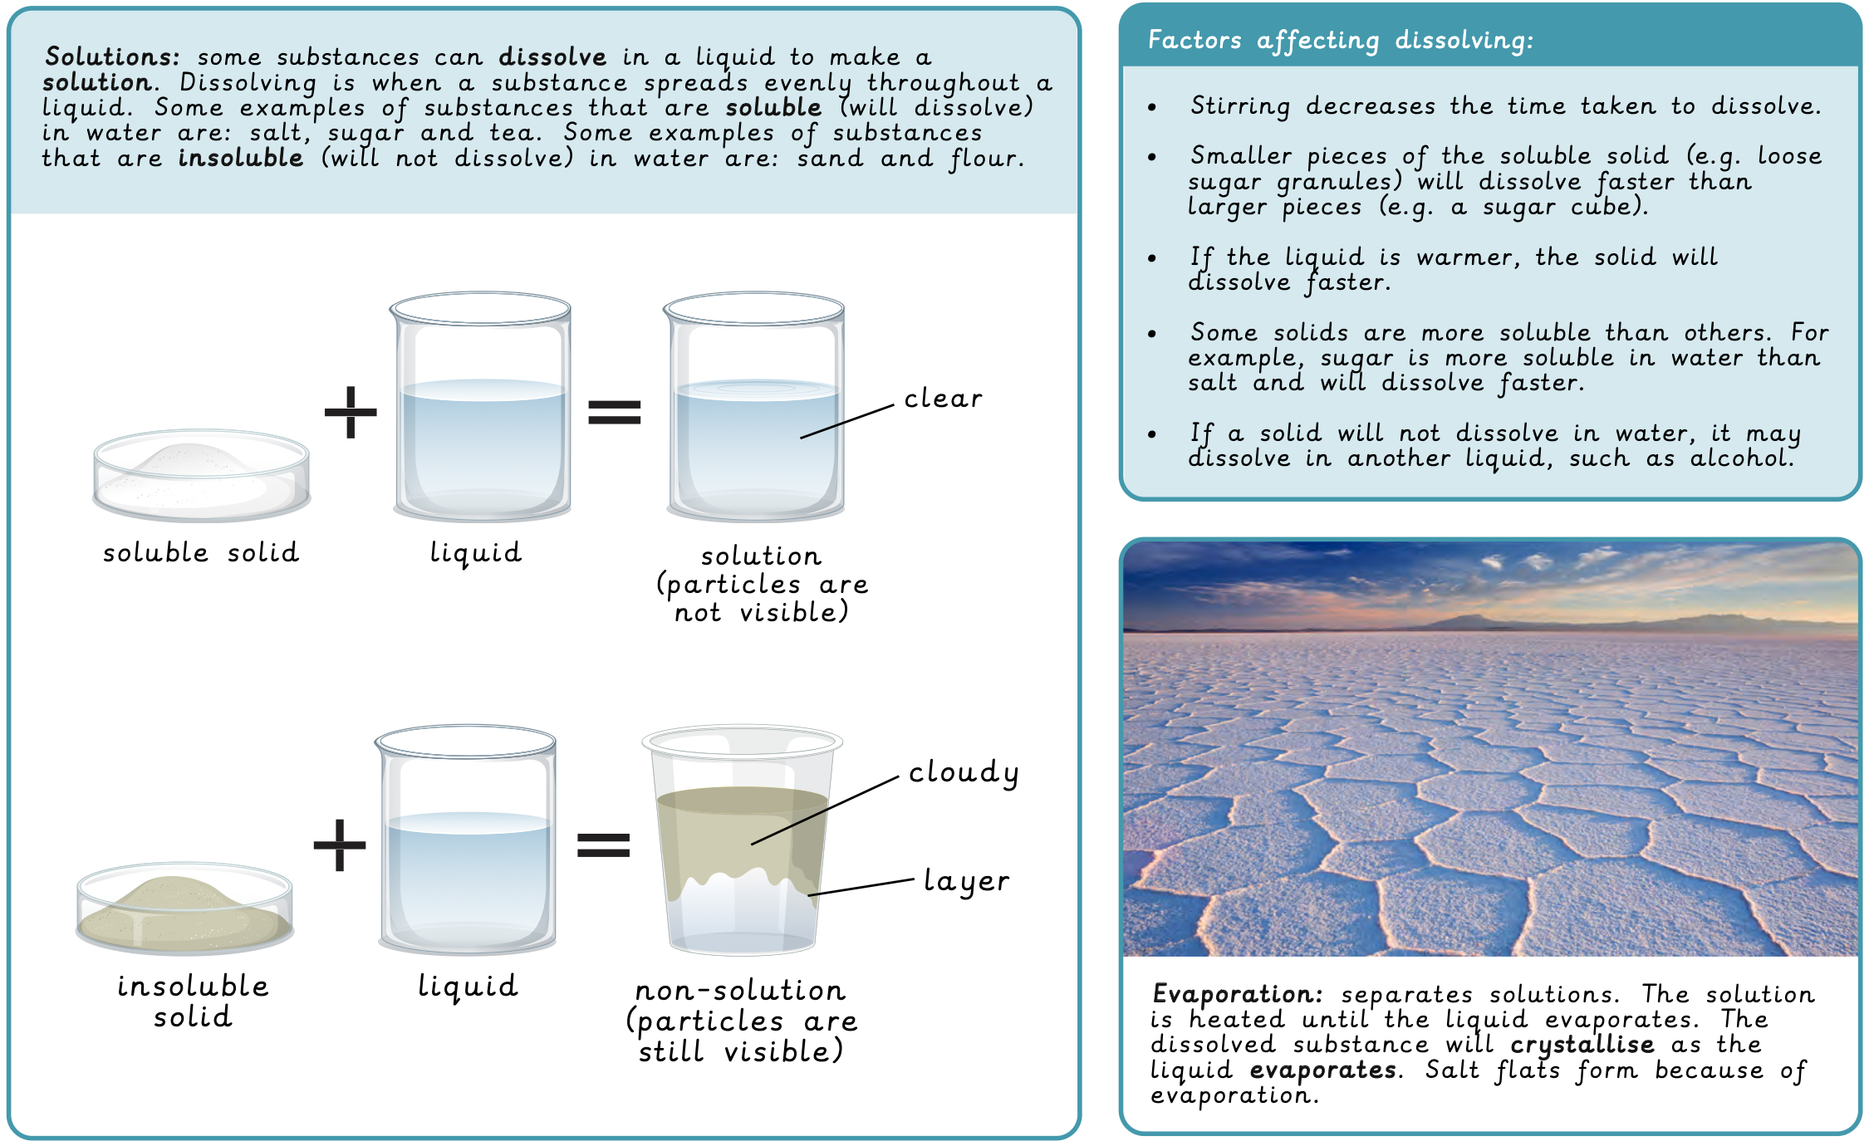
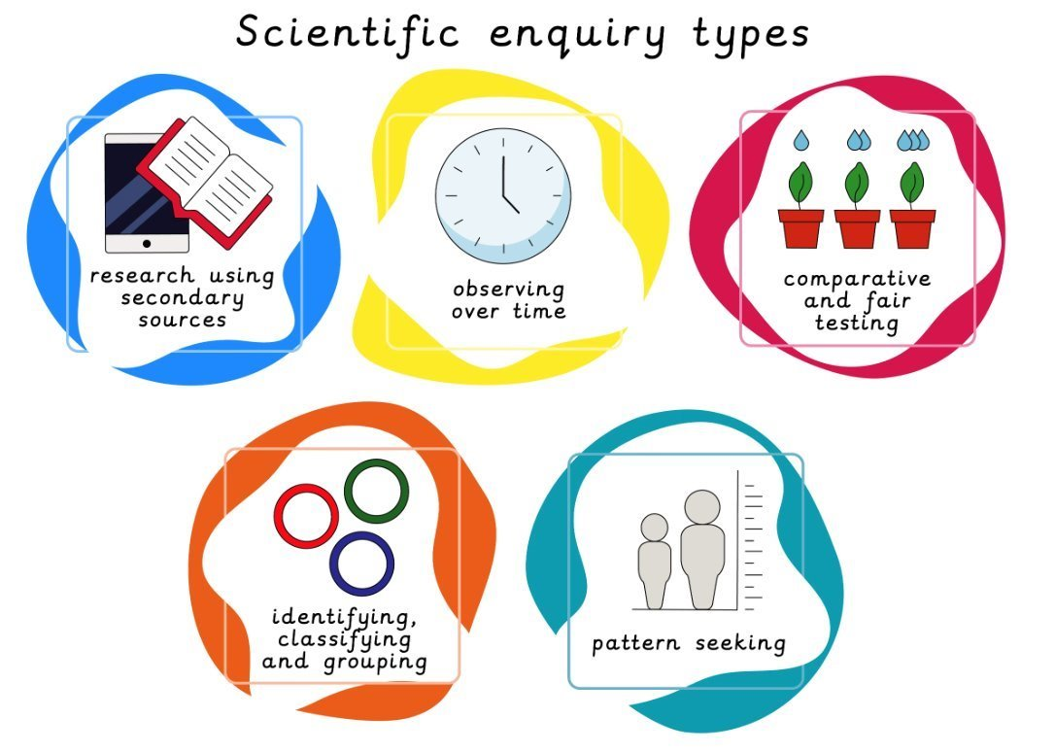
Year 5 Materials: Mixtures and Separations Prior learning: Materials: States of Matter (Year 4)
Lesson 1: Mixtures LO: To describe mixtures. | Lesson 2: Sieving LO: To explain the process of sieving. | Lesson 3: Filtering LO: To explain the process of filtering. | Lesson 4: Solutions LO: To describe solutions and how they can be identified. | Lesson 5: Dissolving LO: To identify which factors affect the time taken to dissolve. | Lesson 5: Evaporating LO: To describe the process of evaporation.
Working Scientifically
To research using a range of secondary resources. To draw and annotate a diagram to explain a concept. To identify testable questions and how to answer them. To make observations about solutions. To plan a fair test with consideration of variables and measurements.

Slide 2
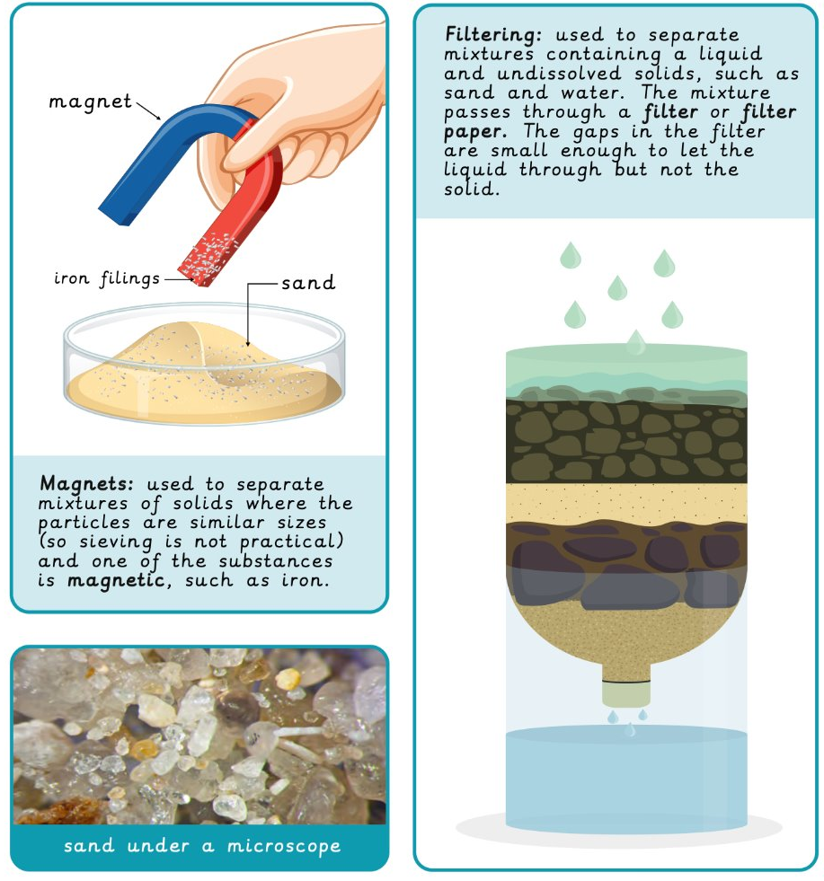
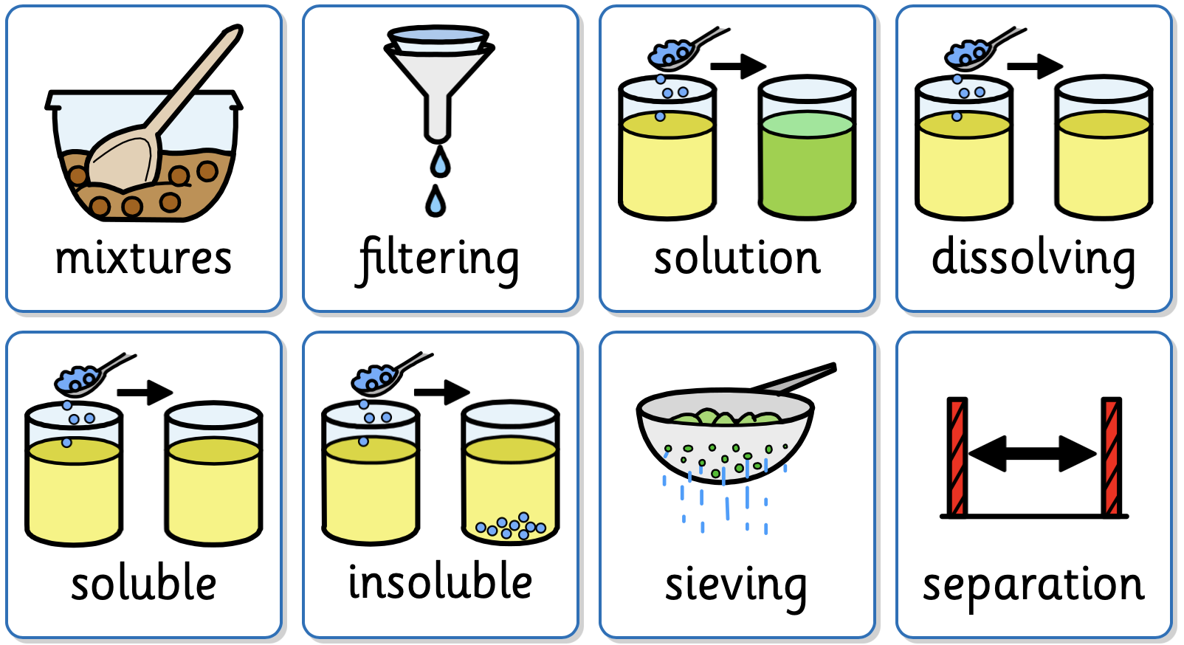
Key Vocabulary
mixtures | Forms when two or more substances are mixed and remain present.
filtering | A process used to separate mixtures containing a liquid and undissolved solids, such as sand and water.
solution | Is formed when one substance is completely dissolved in another.
dissolving | When a substance spreads evenly throughout a liquid.
soluble | Will dissolve in water.
insoluble | Will not dissolve in water.
sieving | Used to separate mixtures of different sizes.

