Slide 1

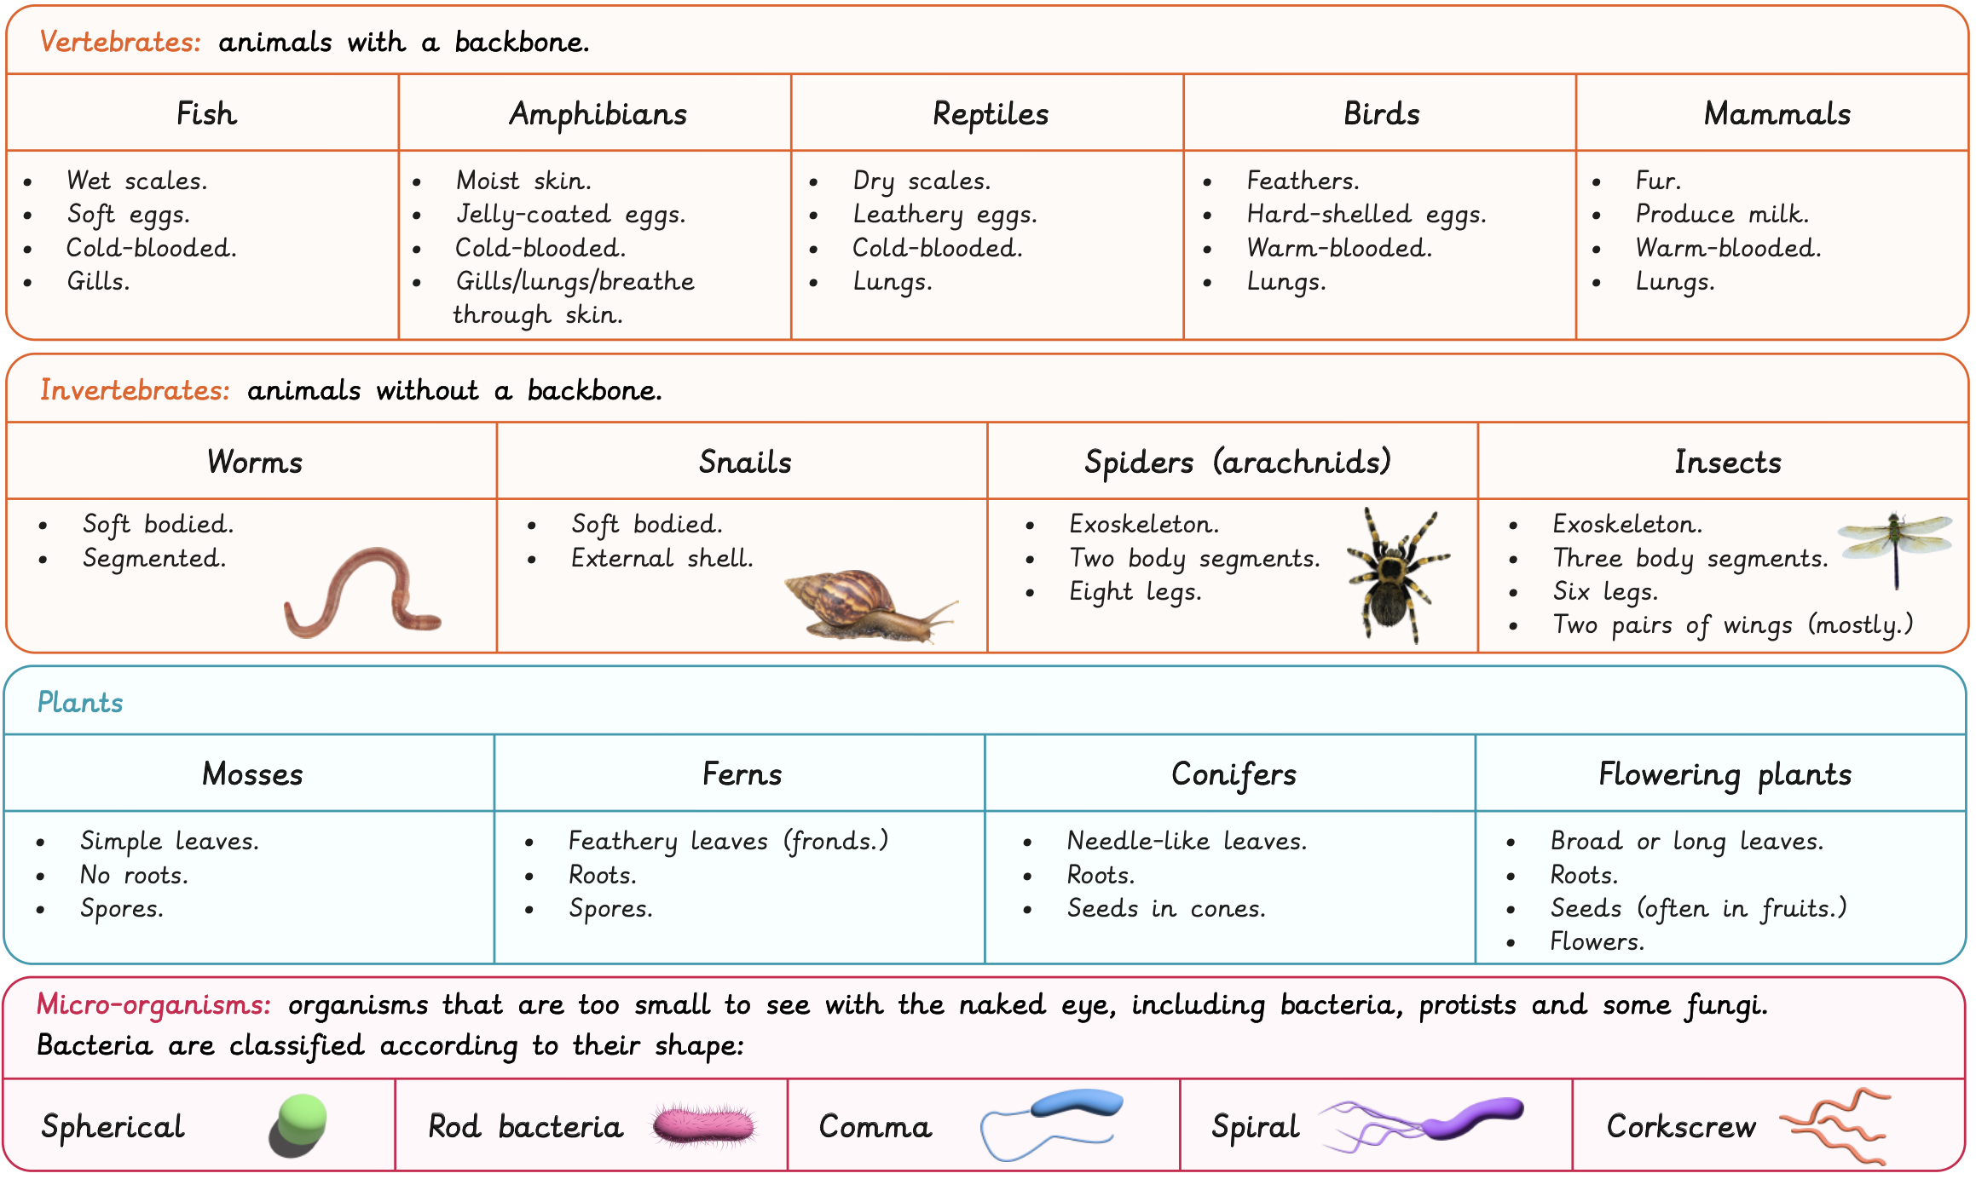
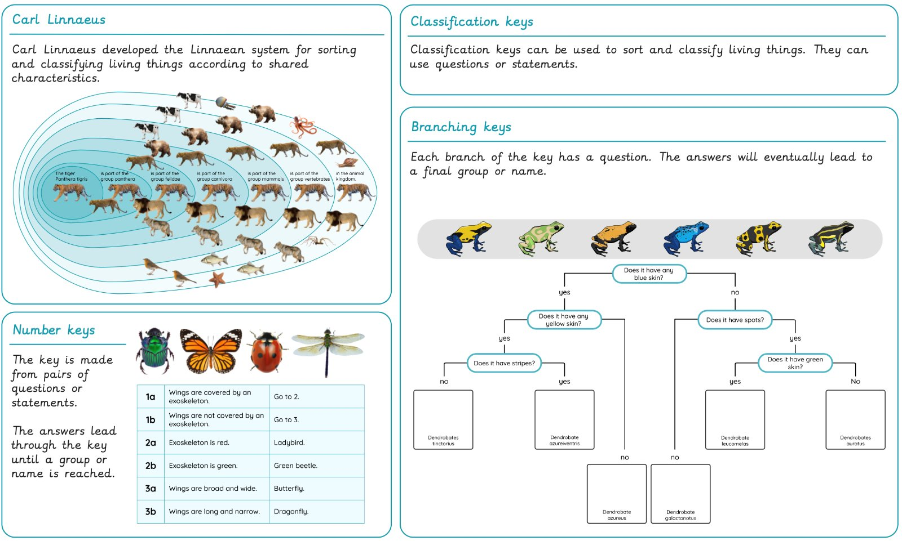
Year 6 Living things: Classifying big and small Prior learning: Grouping animals and plants in various ways (Year 4)
Lesson 1: Carl Linnaeus and classification LO: To explain how organisms are classified using the Linnaean system. | Lesson 2: Cold-blooded vertebrates LO: To classify cold-blooded vertebrate groups using their common characteristics. | Lesson 3: Warm-blooded vertebrates LO: To classify warm-blooded vertebrate groups using their common characteristics. | Lesson 4: Invertebrates LO: To classify invertebrates using their characteristics. | Lesson 5: Plants LO: To describe how the plant kingdom is organised (based on shared characteristics). | Lesson 6: Micro-organisms LO: To describe and classify micro-organisms.
St Joseph's
Catholic Primary
School

Slide 2
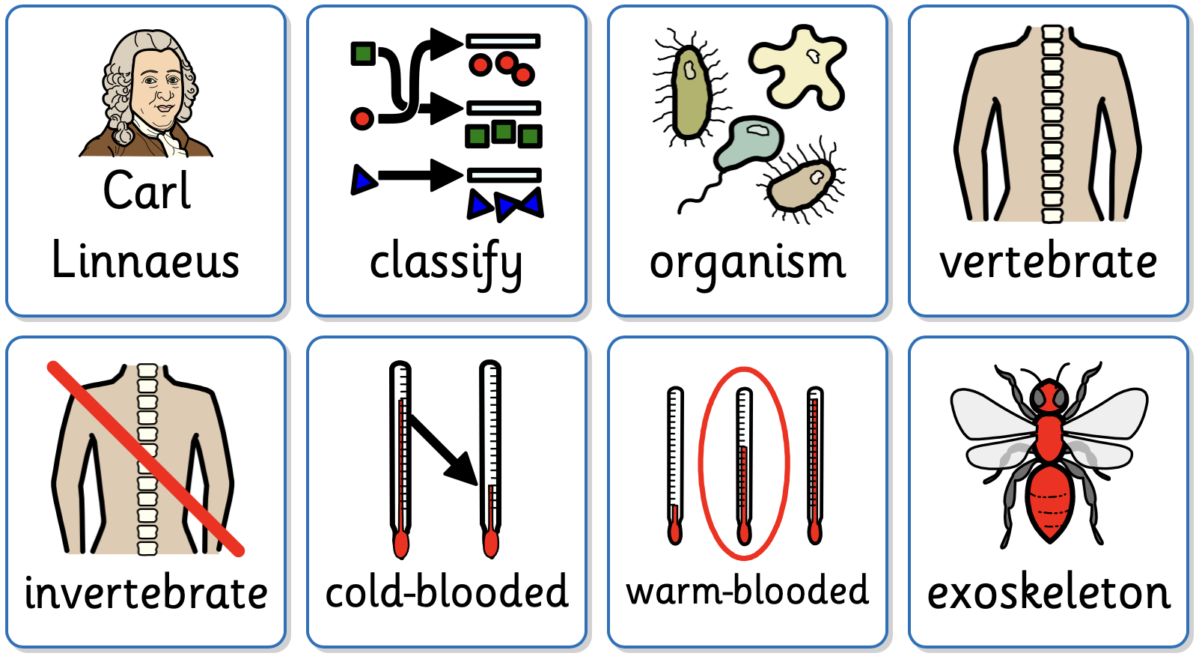
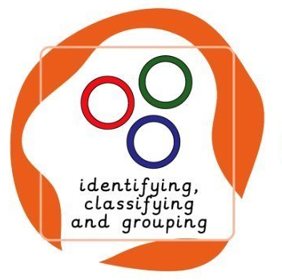
Key Vocabulary
organism | A living thing. A micro-organism is a living thing which is too small to see with the naked eye.
classify | To group something based on similarities.
vertebrate | An animal with a backbone.
invertebrate | An invertebrate is an animal without a backbone.
cold-blooded | Animals that rely on external sources, like the Sun, to control their body temperature.
warm-blooded | Animals that can control their body temperature internally.
exoskeleton | A skeleton on the outside of the body.
Working Scientifically
To use a classification key to classify frog species. To use a classification key to classify vertebrates. To use a classification key to classify vertebrates. To produce a working classification key. To use a classification key to classify bacteria.

